Slide 1
Chatbot Use Cases

Slide 2
Chatbot Use Cases
Cautionary Tale

Slide 3
Summary of Use Cases
Strategy: Company strategy and priorities bot
Product: Product Roadmap Bot (what's coming, when, what you need to know)
Marketing: Marketing Ops Documentation
Sales: Sales Enablement Bot (product description, positioning strategy, key talking points, etc.)
Finance: Quarterly Financial Results
Execution: Project Portfolio Status Updates
Customer Support: Customer Service On-Boarding Bot
HR: HR Benefits Bot
Operations: Ops KPI Bot
Customer Comms: Customer Communications & Press Release Bot

Slide 4

Strategy
Potential Impact: <describe impact>

Slide 5
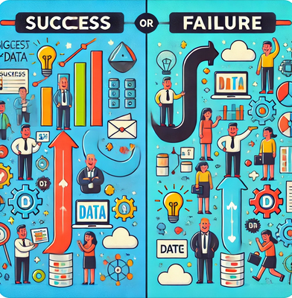


Case Studies – Just because you can?
Netflix
Target’s Predictive Analytics Misstep
One notable unsuccessful Big Data implementation involved Target's use of predictive analytics. The company developed a system to predict customer pregnancies based on purchasing patterns. However, this led to a privacy debacle when Target inadvertently revealed a teenager's pregnancy to her family through targeted marketing materials. This case highlights the potential pitfalls of Big Data when privacy concerns are not adequately addressed, demonstrating the importance of ethical considerations and clear communication with customers in data-driven decision-making
Netflix is a prime example of a successful Big Data implementation. The company uses Big Data analytics to understand subscriber behavior and viewing patterns, which allows it to recommend movies and TV shows tailored to individual preferences. This personalized recommendation system is powered by collecting and analyzing vast amounts of data from its 151 million subscribers. As a result, approximately 80% of the viewer's activity on Netflix is driven by these personalized recommendations, significantly enhancing user engagement and satisfaction.

Slide 6
Q&A

Slide 7
Coding Exercise
> git clone https://github.com/marty916/Enterprise-LLM-RAG.git
> cd Enterprise-LLM-RAG/lessons/02-usecases

